Slide 1
Structure and Purpose of Data Repositories
- XML data
- relational databases - multi-dimensional databases - big data
ISIT 420

Slide 2
4 models
A database is an organized collection of data.
The data is organized in a way that reflects the intended use of the data.
What is stored
What format stored in
What relationships are built in
Performance of single insert/read, versus large queries
We will look at 4 models
XML data
relational databases
multi-dimensional databases
big data

Slide 3
Focus of this course
Better understand which data model is the best tradeoff for a given situation
Learn how to access these data models from programs
Become experts in SQL, Hadoop, or BI Modelling

Slide 4
XML data (or json)
Is an example of a document oriented data structure.
XML defines encoding in a format which is human-readable and machine-readable
XML databases are a type of structured document oriented database that allows querying based on attributes that are specified in the XML description.
In this way, they are “self documenting”.

Slide 5
XML Uses
Data from relational databases
DataSet in ADO.NET
Schemas describing data
RDL - Used with SQL’s reporting services
XSD - Extensible Schema Definition specifies how to formally describe the elements in an XML document. This description can be used to verify that each item of content in a document adheres to the description of the element in which the content is to be placed.
Often used for machine-to-machine data interoperability (company to company).

Slide 6
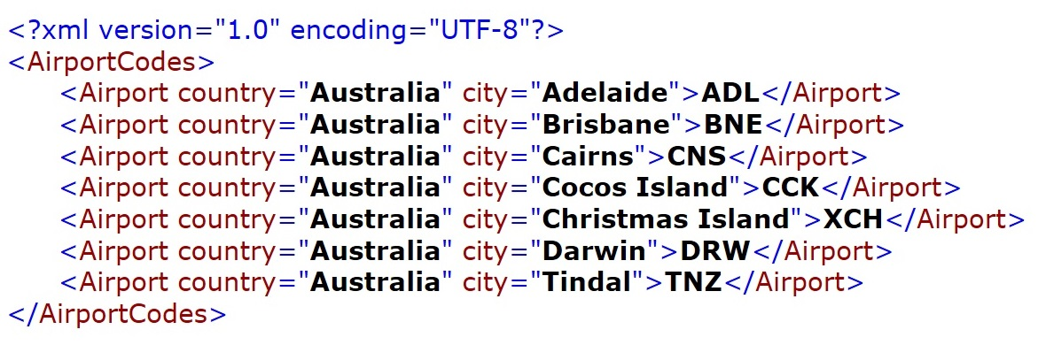
Simple XML file
XML declaration
1 root element (2 tags)
child (nested) elements (2 tags)
elements have text content, & can have attributes
in name/value pairs (must be quoted)

Slide 7
XML – Must be Well Formed
XML document must have a single root element
All elements must be closed
Capitalization of open and closing tags of elements must be consistent
Elements must be nested correctly
Attribute values must be enclosed in quotes
An attribute cannot be repeated in an element
Check your XML at http://xmlvalidation.com/

Slide 8
Relational Databases

Slide 9
Relational Databases
The concept stemmed from the fact that data was organized in tables which have one or more columns (fields), with rows of data.
Relationships are defined between tables with primary ⬄ foreign keys
An important rule when designing databases: Each type of entity about which we want to be able to store information should be given its own table.
Designing a new application often starts with the process of planning out the entities, tables, and relationships between the tables for a database design.
Generally the goal is to optimize data storage (eliminate redundant data), avoid maintenance problems, and better protect the integrity of the data (referential integrity).

Slide 10
Normalization http://databases.about.com/od/specificproducts/a/normalization.htm
A set of concepts documented by E.F. Codd that, when followed, creates a stable, easy to understand, reliable database
Three levels are almost always sufficient to bring a database to a consistent, optimized state.
Sometimes a fourth level is used, and extremely rarely a fifth level is used.
Most complete article:
ttp://www.phlonx.com/resources/nf3/

Slide 11
Great video on this
https://www.lynda.com/SQL-Server-tutorials/Database-normalization/71929/78157-4.html

Slide 12
1NF first normal form
Eliminate duplicative columns from the same table.
Create separate tables for each group of related data and in each table, identify each row with a unique column (the primary key).
ManagerA | Subordinate1 | Subordinate2 | Subordinate3 would be bad columns, instead
ManagerA | Subordinate1
ManagerA | Subordinate2
ManagerA | Subordinate3
Likewise, shoving multiple data items in the same column is bad (see next)

Slide 13
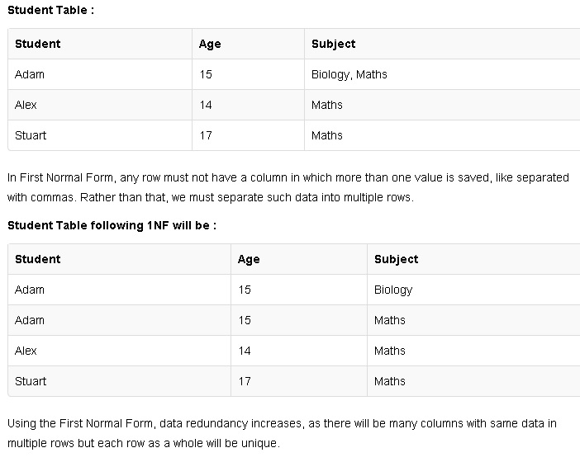
1NF first normal form http://www.studytonight.com/dbms/database-normalization.php

Slide 14
2NF second normal form
Further addresses the concept of removing duplicative data :
Meet all the requirements of the first normal form.
Remove subsets of data that apply to multiple rows of a table and place them in separate tables.
Create relationships between these new tables and their predecessors through the use of foreign keys.

Slide 15
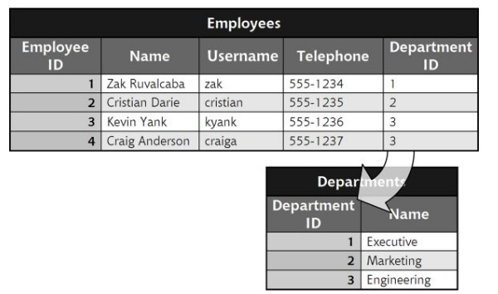
Remove subsets of data that apply to multiple rows of a table and place them in separate tables
Foreign Key
Primary Key
Many different employees might be in the same department, so pull the list of departments out into a separate table.

Slide 16
3NF third normal form
Goes one large step further
Meet all the requirements of the second normal form.
Remove columns that are not dependent upon the primary key.
Suppose have a table of orders that contains:
Order Number
Customer Number
Unit Price
Quantity
Total
Customer Name
Are all of the columns fully dependent upon the primary key?
Customer number varies with the order number and it doesn't appear to depend upon any of the other fields.
The Unit Price field could be dependent upon the customer number if we charged each customer a set price. But in this case, we sometimes charge the same customer different prices, so the unit price is dependent on the order number.
The quantity of items also varies from order to order
But for the total, it can be derived by multiplying the unit price by the quantity, therefore it's not fully dependent upon the primary key. We must remove it from the table to comply with the third normal form.
Can a Customer Name exist without an Order Number? Certainly, the same customer might be on multiple orders, so it must come out.

Slide 17
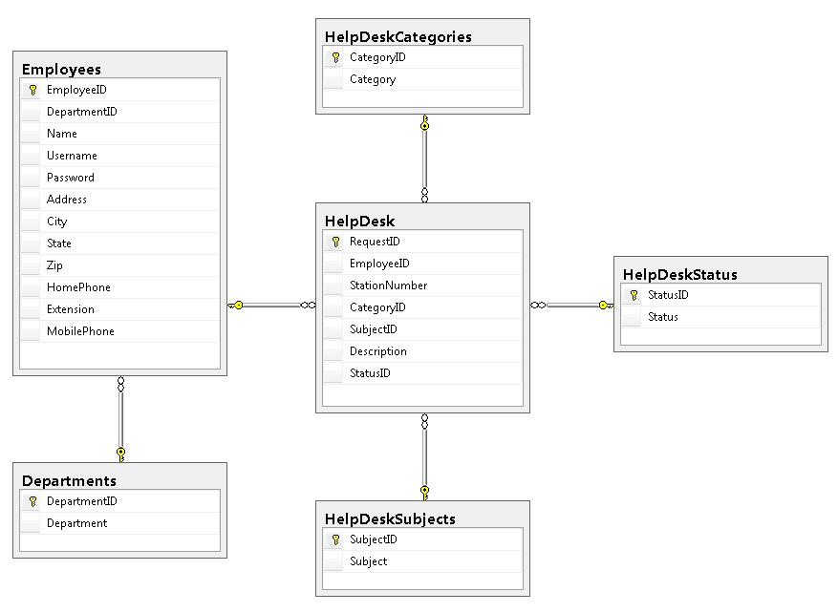
Prog 117 (123?) – Dorknozzle DB Referential Integrity

Slide 18
Queries that retrieve data from multiple tables.
Using an inner join to obtain a list of all employees in the engineering department:
SELECT Employees.Name, Employees.DepartmentID, Departments.Department
FROM Departments
INNER JOIN Employees ON Departments.DepartmentID = Employees.DepartmentID
WHERE Departments.Department LIKE '%Engineering'
SELECT Orders.OrderID, Orders.CustomerID, DVDsOrdered.DVDID, DVDtable.DVDtitle
FROM Orders
INNER JOIN DVDsOrdered ON DVDsOrdered.OrderID = Orders.OrderID
INNER JOIN DVDtable ON DVDsOrdered.DVDID = DVDtable.DVDID
WHERE CustomerID = @CustomerID
Multiple joins across several large tables is quite an I/O and cpu intensive operation.

Slide 19
If normalization if such a good idea, why isn’t all data stored in SQL?
Rdb’s are generally highly normalized as this allows for fast data insertion and / or updates as they affect the fewest number of columns in the fewest number of rows for a single record. (and with smaller chance of hitting locks)
And a simple query, such as “what’ is Zak’s phone number” is also fast.
But very high insertion rates, affecting multiple tables, is not optimized (so we have Big Data --- NoSQL)
Complex queries, such as “All married women in State of WA with 2 or more children who have earned a college degree” require many db engine cycles and are relatively slow. (so we have BI – Cubes)
Company A’s SQL db does not match Company B’s (so we have XML for interchange)

Slide 20
Multidimensional Database (MDB) http://en.wikipedia.org/wiki/Online_analytical_processing#Multidimensional_databases http://www.alphadevx.com/a/36-Comparison-of-Relational-and-Multi-Dimensional-Database-Structures

Slide 21
Multidimensional Database (MDB)
MDB is a type of database optimized for data warehouse and online analytical processing (OLAP) applications.
They are generally loaded with data from existing relational databases that are being updated with real time information.
Instead of using the SQL query language, MDBs are accessed with a MDX query language, or using many business apps such as Excel, SharePoint, and many special purpose built apps that allow companies to make better pricing, inventory, and other decisions.
They allow questions like “which of my cereal brands are selling the most and what is the most common product that is sold at the same time”?
OLAP consists of 3 operations: consolidation , drill-down, and “slicing and dicing”.
Consolidation involves the aggregation of data that can be accumulated and computed in one or more dimensions. For example, all sales offices are rolled up to the sales department or sales division to anticipate sales trends. (The structure used is generally a “cube”.)
Drill-down is a technique that allows users to navigate through the details. For instance, users can view the sales by individual products that make up a region’s sales.
Slicing and dicing is a feature whereby users can take out (slicing) a specific set of data of the OLAP cube and view (dicing) the slices from different viewpoints.

Slide 22
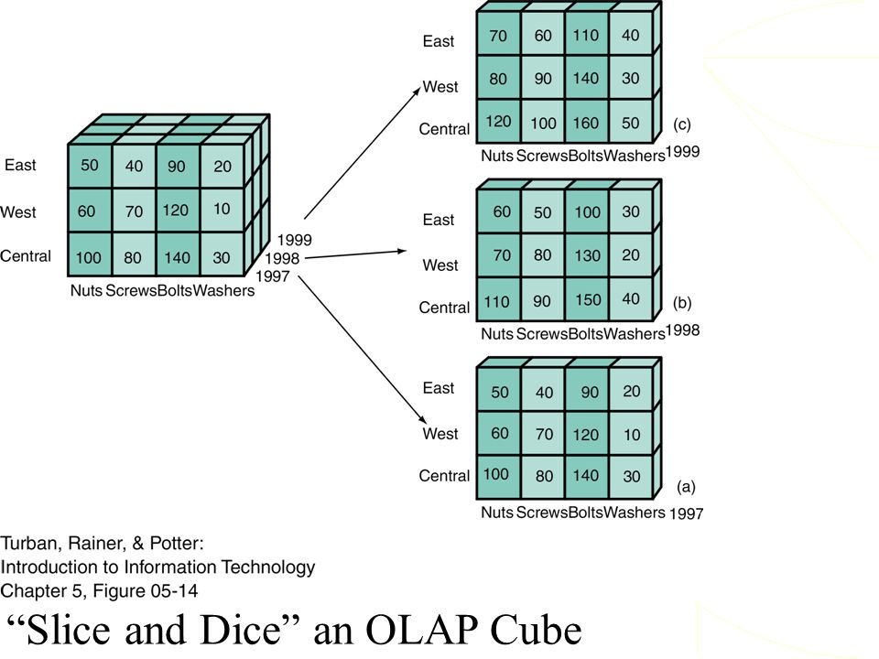

Slide 23
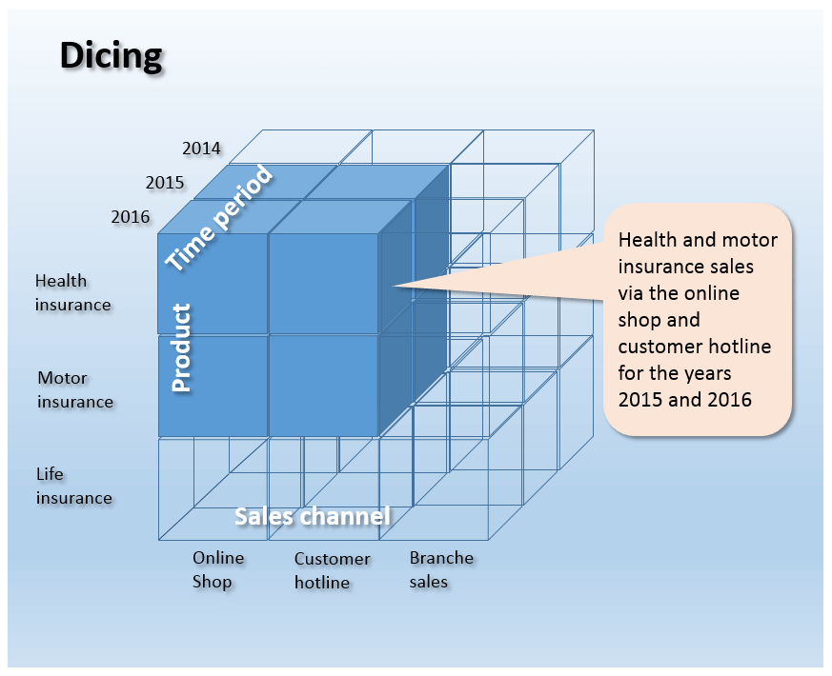

Slide 24
MDB in support of OLAP
It is common with MDB to use a “data cube” model to represent the dimensions of data available to a user.
For example, “internet sales" could be a “fact table” (called a measure) where actual sales activity is stored (facts, data)
It can be interrogated and correlated across several “dimensions” such as geography, time, and product detail dimensions.
Dimension attributes are often broken down into hierarchies such as Year, Quarter, and Month.
MDBs are generally quite de-normalized to support fast, complex queries. This is less optimal for data storage space, but optimizes complex query speeds.
Technologies such a SSIS (SQL Services Integration Services) are used to periodically refresh the fact tables, such as at the end of a retail day.
Fact Tables 1. Provides measurement of an enterprise, in numeric or integer form, determined by observation.
2. Size of Fact Table is larger than Dimension Table.
3. Fact table data has foreign keys that refer to primary keys in the dimension tables.
4. A dimension table consists mainly of descriptive attributes that are textual fields.

Slide 25
simple example
A cube that contains a store's sales as a measure, and Date/Time and Product as a dimensions. Each Sale has a Date/Time label, Prod, etc that describes more about that sale.
Sales Fact Table
sale_id | sale_amount | time_id | Prod_id | …
12134 | 208.10 | 1364 | 789 | …
12135 | 600.50 | 1456 | 236 | …
… | … | … | … | …
Time Dimension
Product Dimension
time_id | timestamp
1364 | 20140902 12:35:43
1365 | 20140902 12:37:14
… | …
Prod_id | English Desc | List Price | Color | …
789 | Xbox 360 Console | 240.00 | Black | …
790 | Xbox 360 Controller | 24.99 | White | …
… | … | … | … | …

Slide 26


Big Data NoSQL

Slide 27
Big Data and NoSQL
Big data is an general term for any collection of data sets that are so large and/ or with such high throughput requirements, that it becomes very hard and or expensive to use a relational data base. These data requirements require that multiple (10? 100? 1000?) computers share the load of one large database. Often technologies such as “NoSQL” are used for these situations.
A NoSQL database general means a database that has a simple key-value store. They were built to accommodate the modern world wide web where data streams (txt messages, FB, real time cash register feeds, etc.) generate extremely high volumes of data at high data rates. Traditional SQL DBs could not effectively, economically deal with these data rates and this much data.
NoSQL databases trade off speed over function. They do not have fixed table schemas, they avoid join operations by storing denormalized data, and are designed to scale by feeding the data to multiple machines (10’s 100’s or even 1000’s). MongoDB, and CouchDB are examples and are open-source software products.
A common way of processing such Big Data is with “MapReduce” (and Hadoop is a widely used implementation)

Slide 28
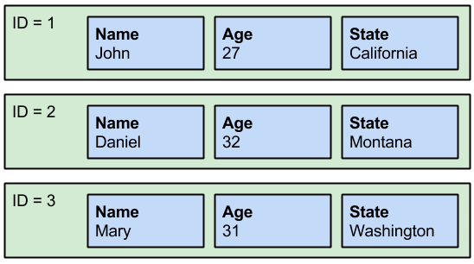
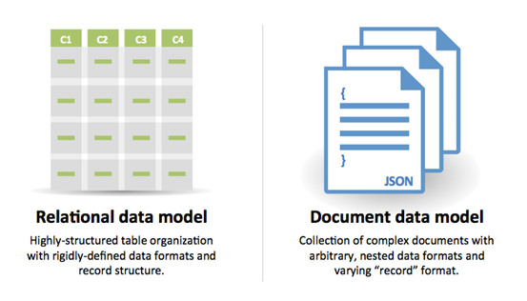
City
Butte

Slide 29
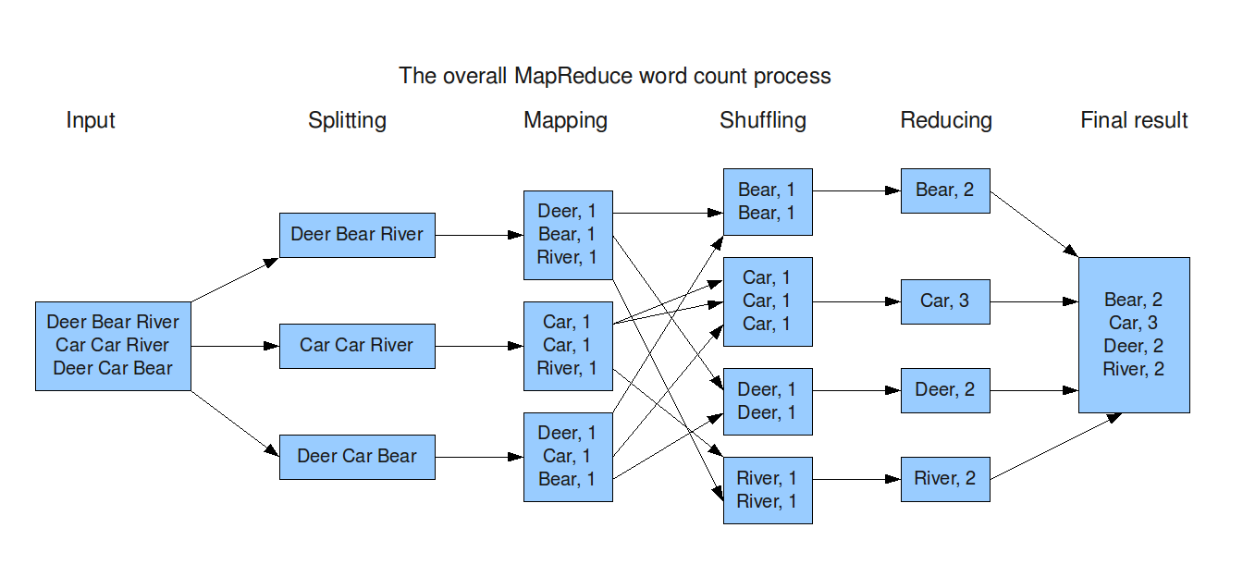
MapReduce http://xiaochongzhang.me/blog/?p=338

Slide 30
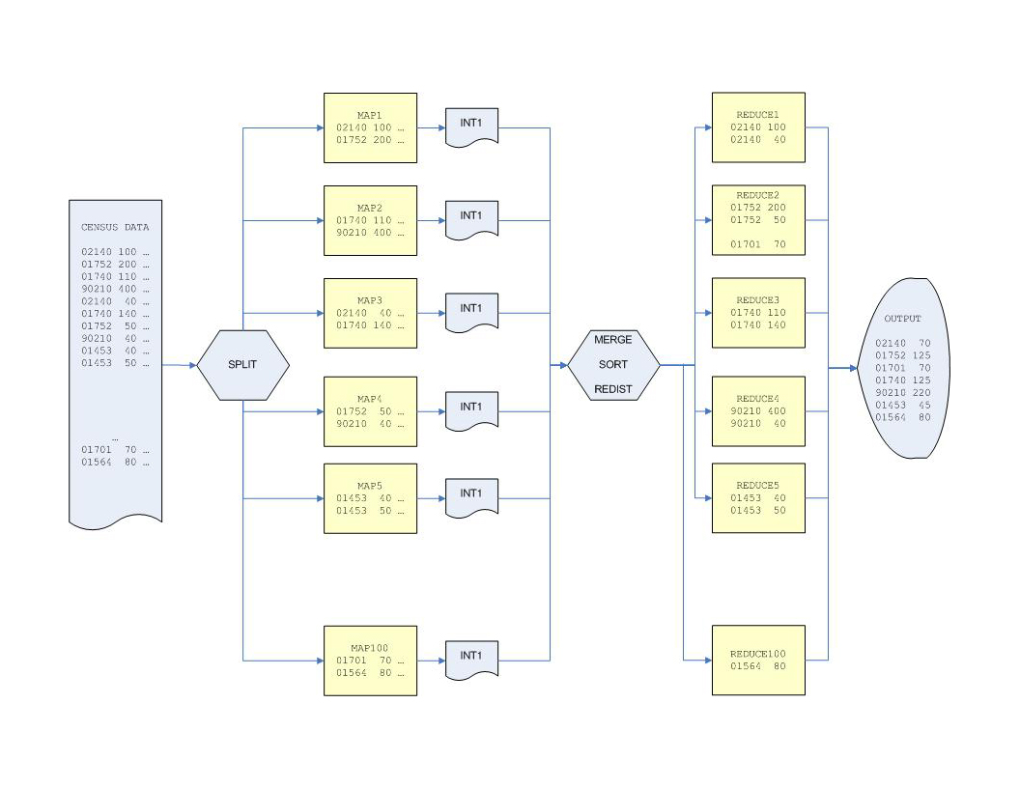

Slide 31
With MapReduce
Partitioning the data across multiple machines allows for very high update rates and analysis speeds, but, there is a computer science theorem (CAP) that states it is impossible for a distributed system to simultaneously provide consistency, availability and partition tolerance guarantees.
A distributed system can satisfy any two of these guarantees at the same time, but not all three. For that reason NoSQL databases rely on “eventual consistency” to provide both availability and partition tolerance guarantees with a reduced level of data consistency.
For this reason, accounting data, like a payroll system, would not use NoSQL, because even one incorrect pay check is considered a big problem. However if the WalMart marketing manager sees that 2,471 Hot And Spicy Frito's were sold in the last hour, and it was actually 2,479, that is considered ok.

